Slide 1
Patient Experience In Public Healthcare
By Khoa, Martin, Neha, Esther, Lisha

Slide 2
TABLE OF CONTENTS
01.
02.
03.
04.
OVERVIEW
SEPARATE
ANALYSIS
JOINT
ANALYSIS
CONCLUSION
A brief explanation of the topics
An analysis of healthcare system by different factors
A joint analysis to unravel potential correlation
Quick capture of main points

Slide 3
01. OVERVIEW
An introductory guide to the project and dataset before going through in-depth analysis, including problem statements, dataset and data introduction.

Slide 4
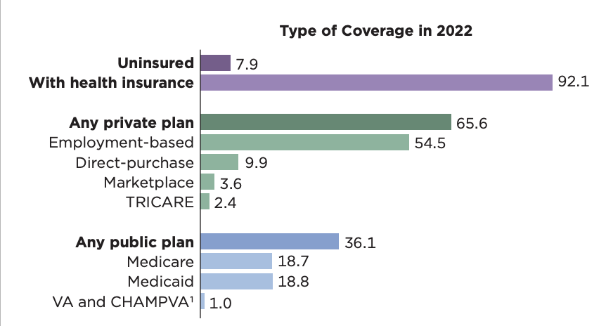
PROBLEM STATEMENT
Insurance system in the U.S is complex and expensive
Private insurance has multiple options.
Public insurance has limited options and always been topic of controversy on efficiency
The goal is to understand the general patient experience going through public healthcare
Additionally, to understand what is important and what can be improved

Slide 5
DATASET
Data acquired from Centers of Medicare and Medicaid Services
Payment and Value of Care Measures: Details Medicare fundings and compare hospital rates nationally
HCAHPS Patient Survey: Assesses hospital experiences based on patient feedback.
Timely and Effective Care Measures: Evaluate treatment effectiveness and speed.

Slide 6
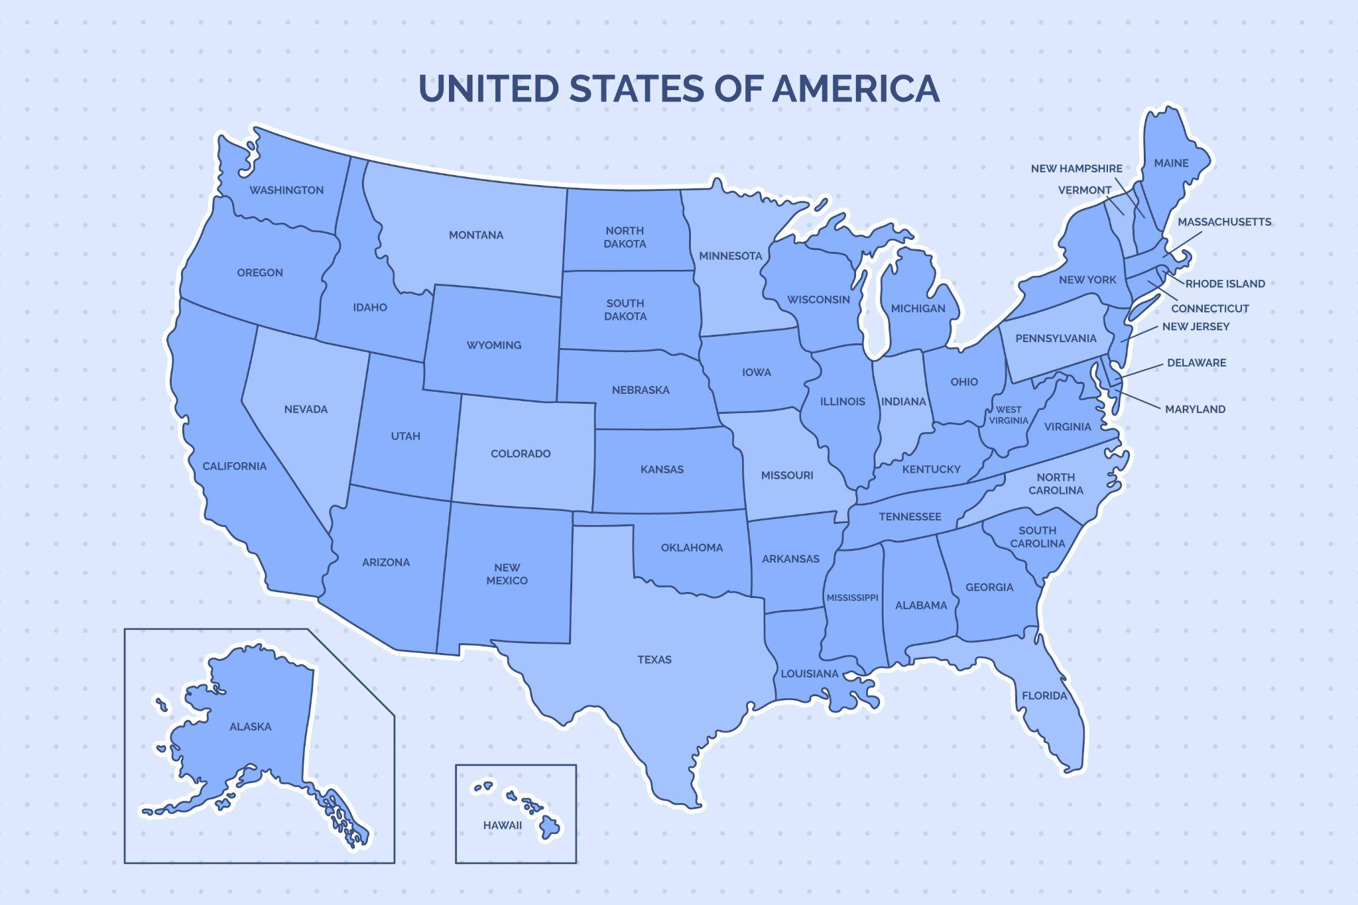
4,510
Number of facilities
54
Number of States and Territories
214,466,374
Dollars of payment made in 2023
3
Levels of analysis

Slide 7
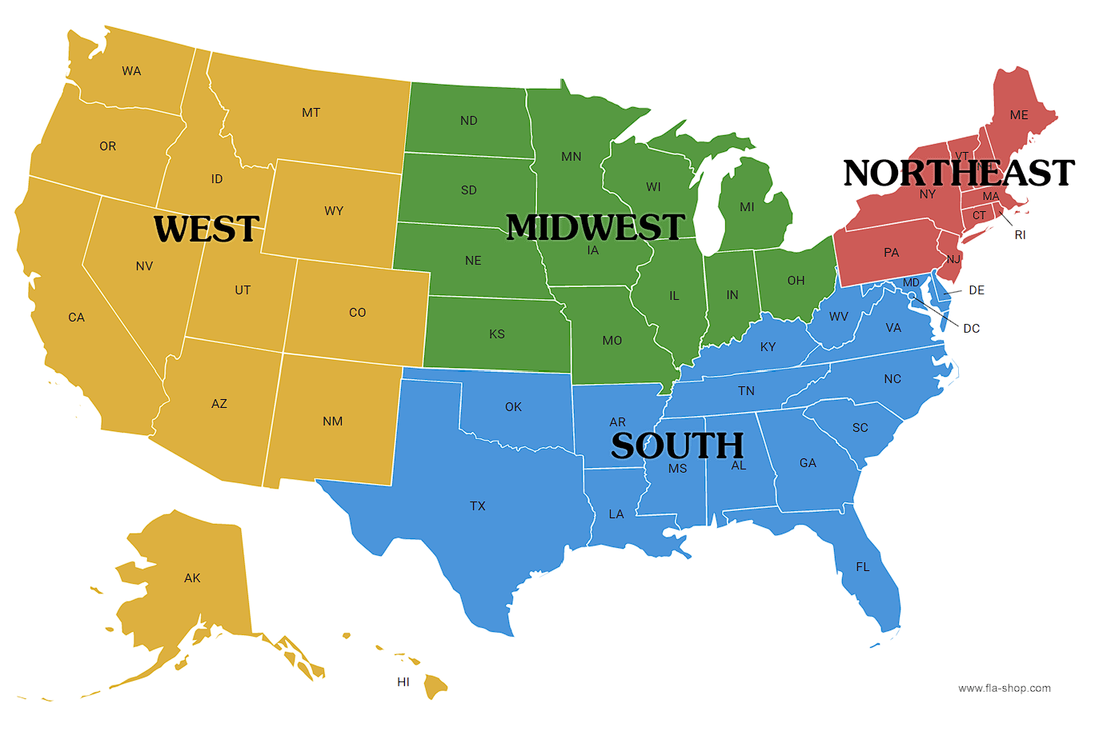
Levels of analysis:
Nationwide
Per region
Per selected states

Slide 8
02.
SEPARATE ANALYSIS
Let’s look on each sub part of Satisfaction System

Slide 9
SEPARATE ANALYSIS
2.1
BY PAYMENT
2.2
BY PATIENT SATISFACTION
2.3
BY TIMELINESS AND EFFECTIVENESS
Amount of money from government to hospital for public healthcare
How patient rate their experience using public healthcare
How well patients receive emergency and care from a more objective standpoints

Slide 10
2.1 PAYMENT
Payment : Amount funded by Government to Public hospitals
Disease selected :
Heart attack
Heart failure
Knee hip replacement
Pneumonia

Slide 11
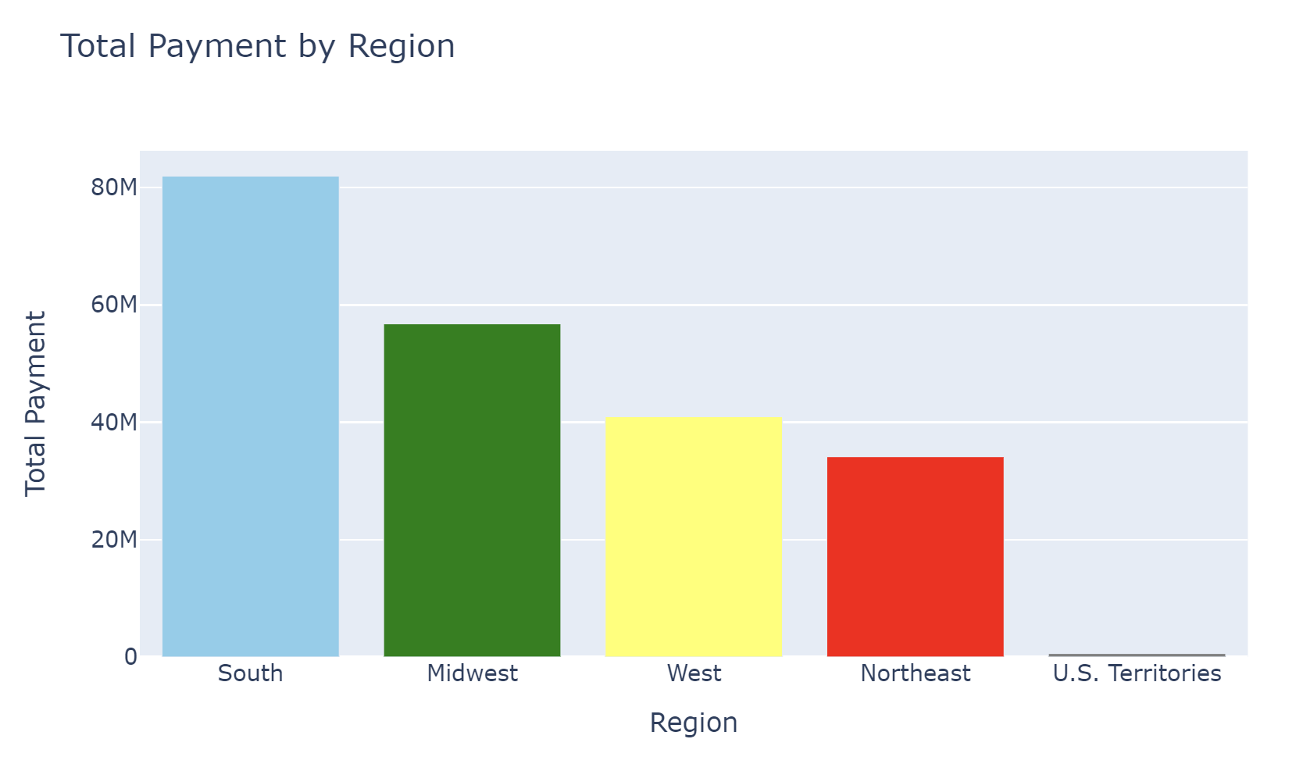
2.1 PAYMENT: Region wise
Total amount paid for all regions
214 Million

Slide 12
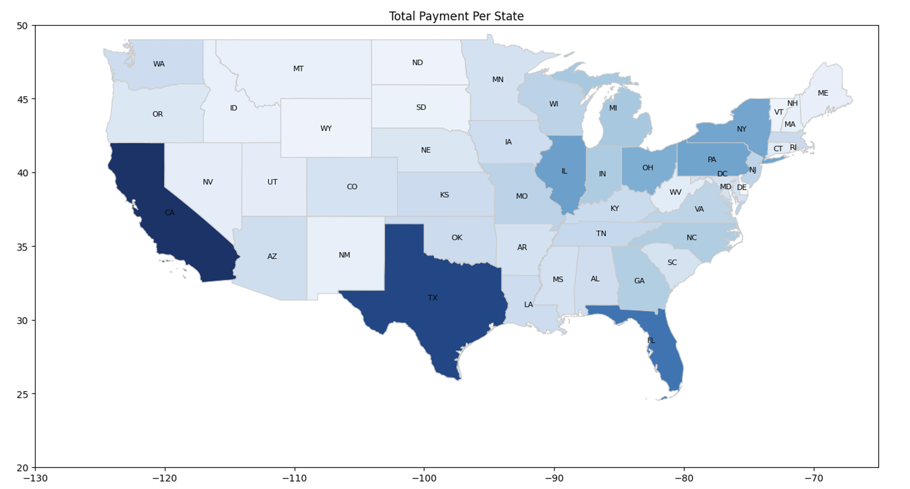
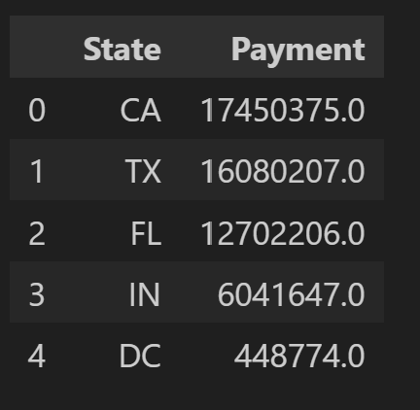
2.1 PAYMENT: State wise
Top 5 highly funded States Reason :
Highest : California Lowest : US territories
Reasons assumed :
Large Population
Higher Number of Facilities

Slide 13
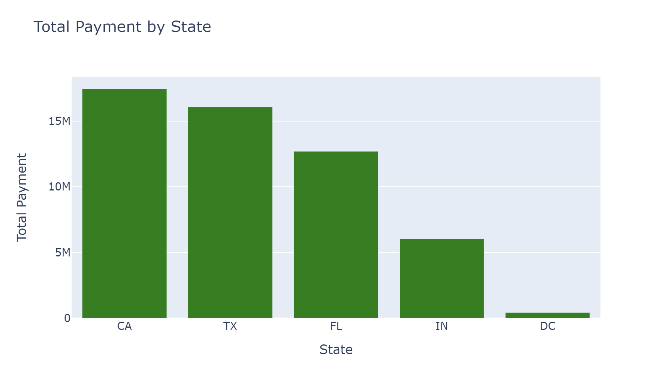
2.1 PAYMENT: State wise
Top 5 highly funded States Reason :
No of facilities high = More funding

Slide 14
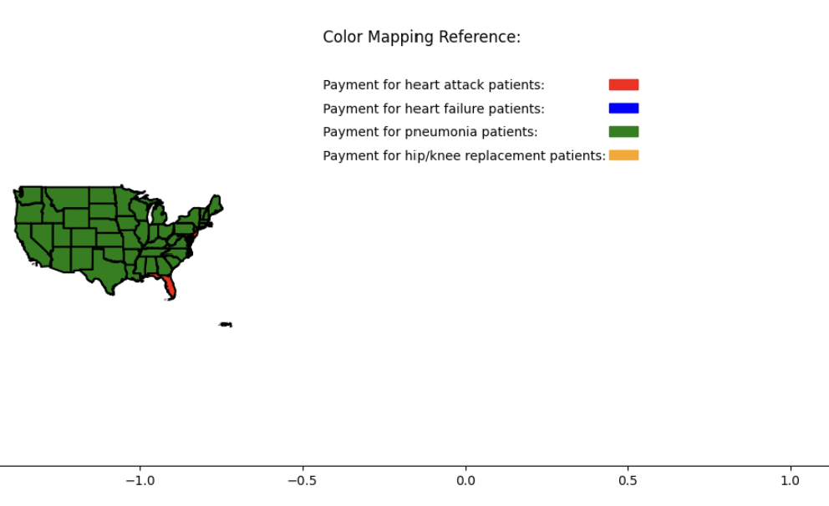
2.1 PAYMENT: Disease-wise : All States

Slide 15
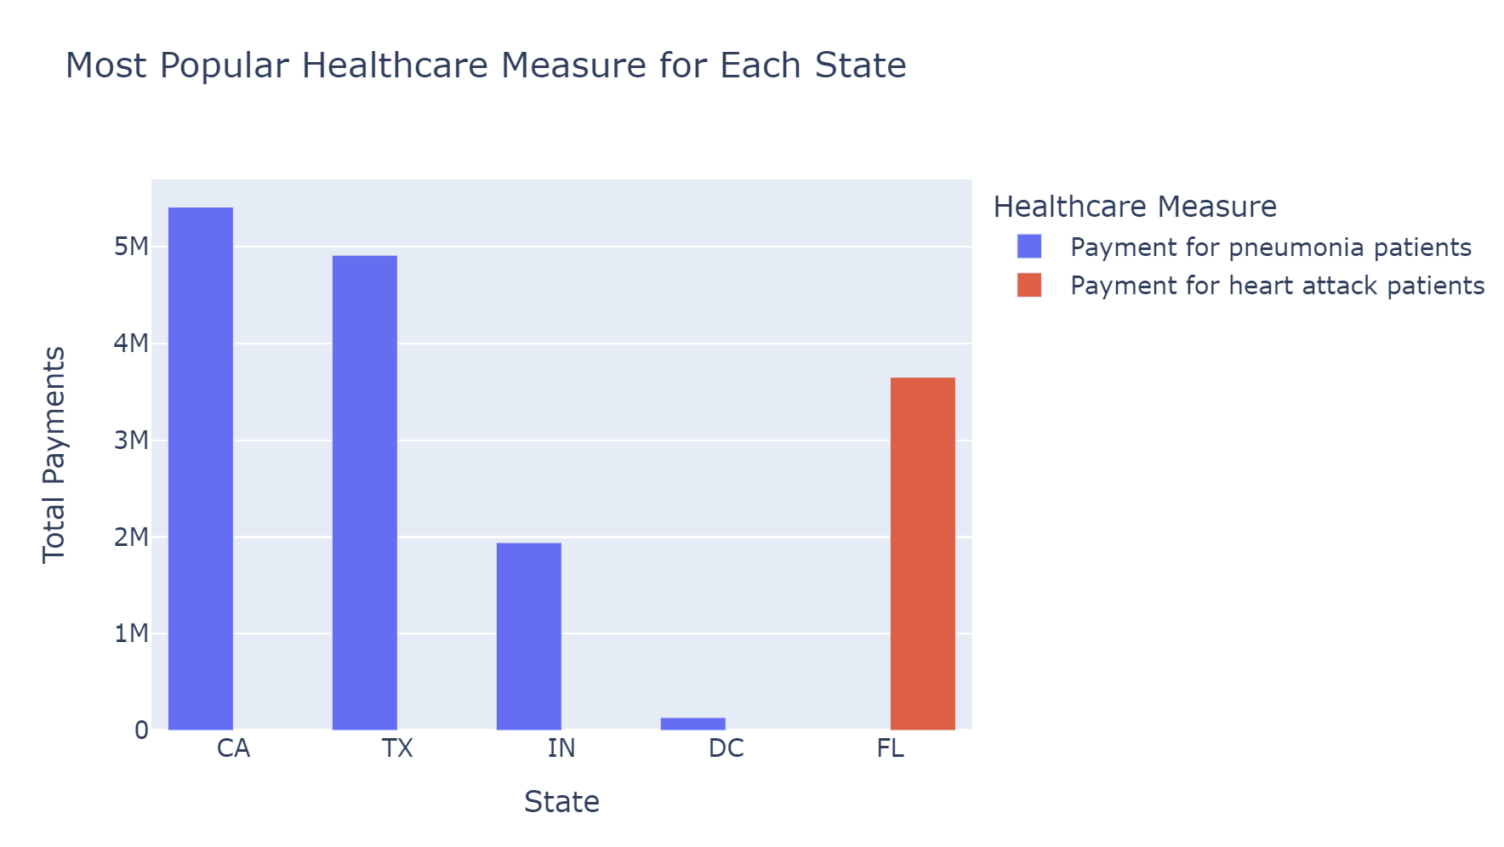
2.1 PAYMENT: Diseases-wise: 5 Selected States
Most Recorded/Popular Disease through 5 Selected States :

Slide 16
2.1 PAYMENT: Conclusion
By Region
Highest funding: South
By States:
Highest funding : California - Texas - Indiana - Florida - District of Columbia
Health condition highest funded:
California- Texas - Indiana - Florida : Pneumonia
District of Columbia : Heart Attack
By Disease Count
Highest recorded Disease : Heart Attack

Slide 17
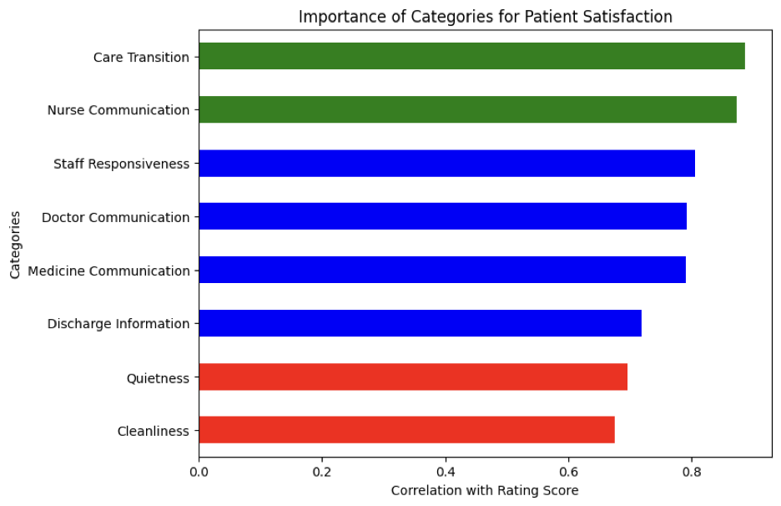
2.2 HOSPITAL EXPERIENCE
By doing a general analysis of all the eight factors for Patient Satisfaction, we could tell that Care Transition and Nurse Communication are the two factors that ranked the highest in all the regions. Whereas, Quietness and Cleanliness are ranked the least.

Slide 18
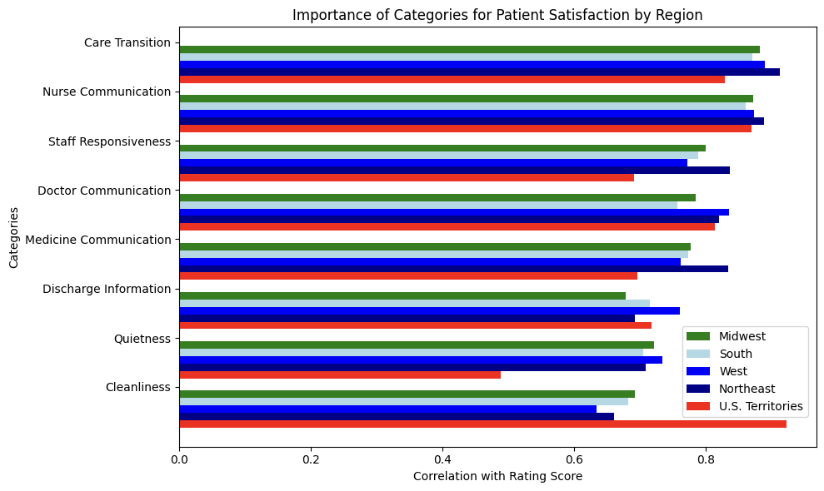
Overall Importance of categories by Region
All the US states range around the same values in all the attributes in patient satisfaction. We can see some trends, for example U.S Territories has much higher importance on cleanliness. The Northeast have a few different trends than the other regions.

Slide 19
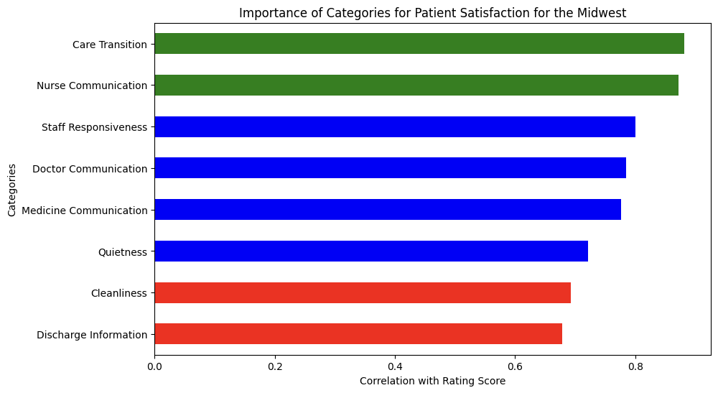
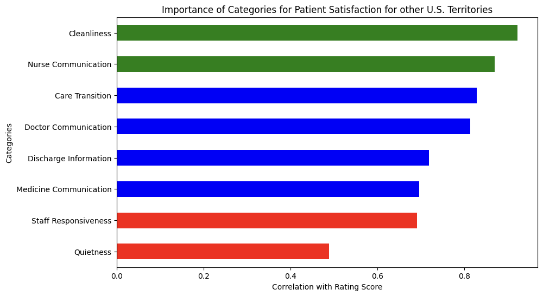
Comparison of Categories to other Regions
In the Midwest, discharge information is not as important a factor as the rest of the categories, compared to nationwide.
In Other U.S Territories, cleanliness is a very big factor in Patient Satisfaction. On the other hand, Quietness is a smaller factor than anywhere else.

Slide 20
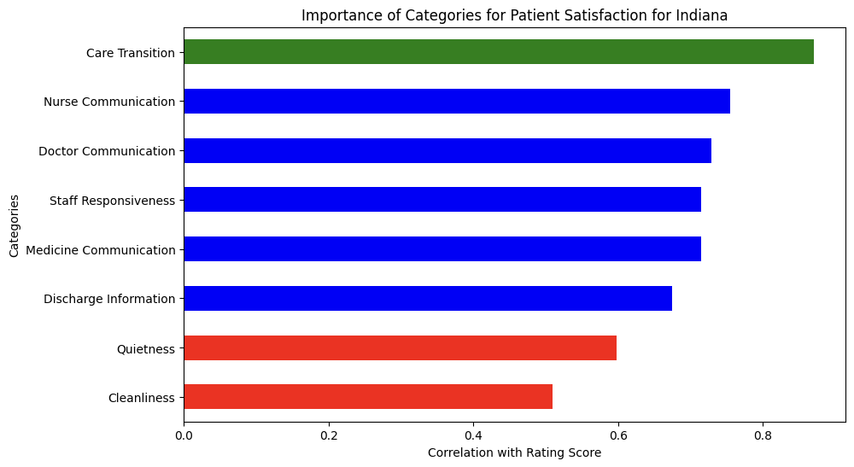
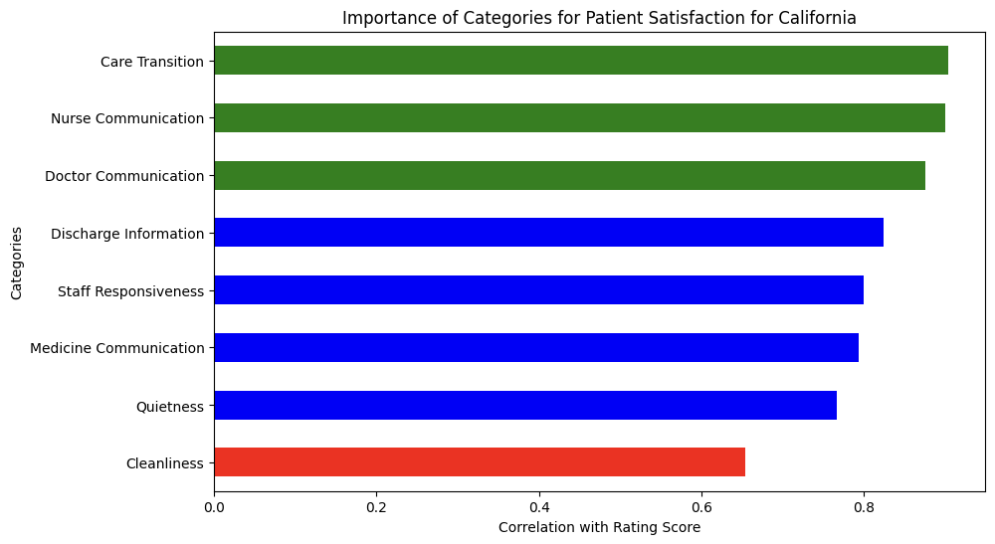
Analysis by State
Indiana has much higher importance on Care Transition than the other categories. The rest of the categories follow national trends.
In California, Doctor communication is almost as important as Nurse communication.

Slide 21
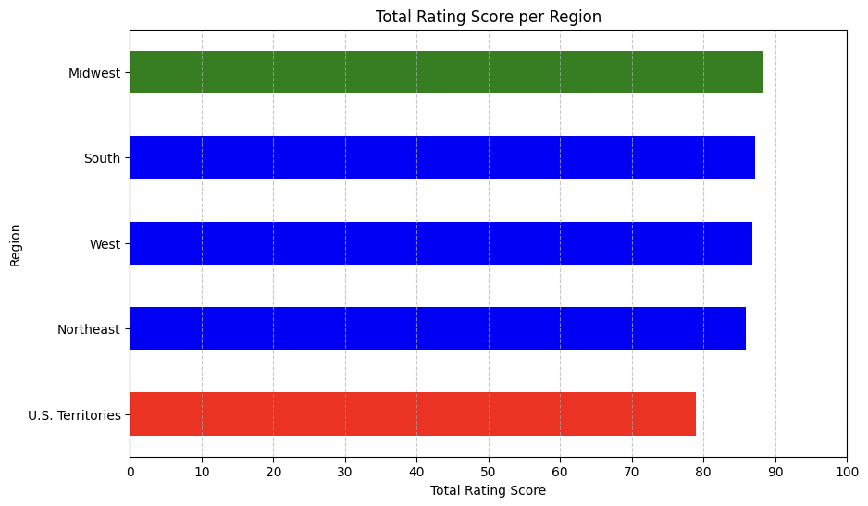
Overall Rating Score Comparison by Regions
Midwest has slightly highest score on overall patient satisfaction. Other U.S. Territories has lowest overall rating score.

Slide 22
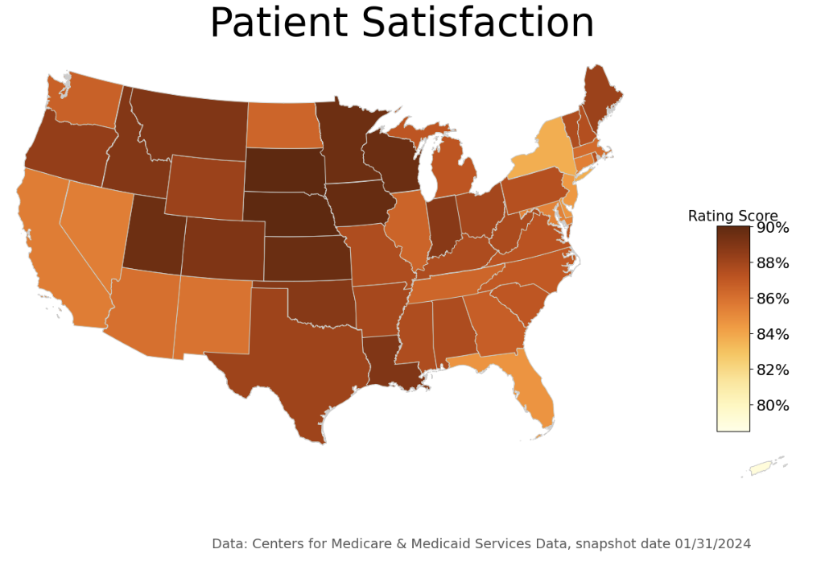
Rating score comparison by State
Also, the analysis by state shows a very similar score than overall patient satisfaction.

Slide 23
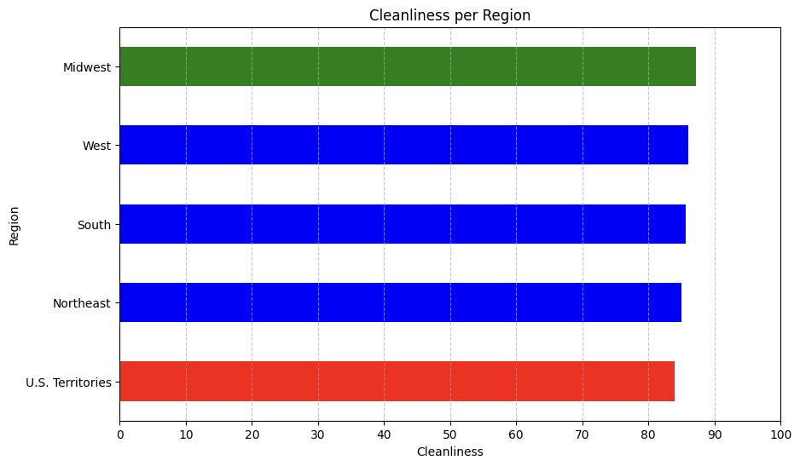
Rating score comparison by Region
Since cleanliness is one of the attribute that was rated the lowest, we did some analysis on the attribute to derive some information. Midwest ranked highest among the other regions and other U.S territories were expected to have lower score on cleanliness due to their high importance, but it was not as high as expected.

Slide 24
2.3 TIMELY AND EFFECTIVE CARE
EMERGENCY-1 : Percentage of Leaving Emergence Without Being Seen
EMERGENCY-2 : Number of Minutes Patients Spent in the ER before being sent home.
PERSONNEL VACCINATION : Vaccination Coverage among Personnel
STROKE : Percentage of Patients Receiving brain scan results within 45 minutes of arrival
HEART ATTACK: Number of Minutes Before outpatients with chest pain or possible heart attack who needed specialized care were transferred to another hospital

Slide 25
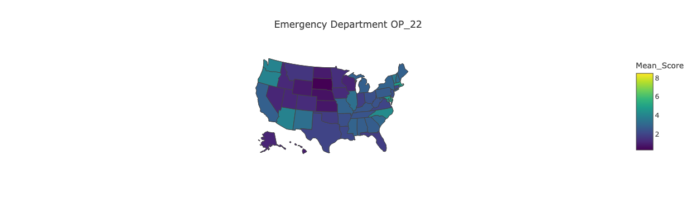
2.3 TIMELY AND EFFECTIVE CARE - EMERGENCY-1
Percentage of Leaving Emergence Without Being Seen

Slide 26
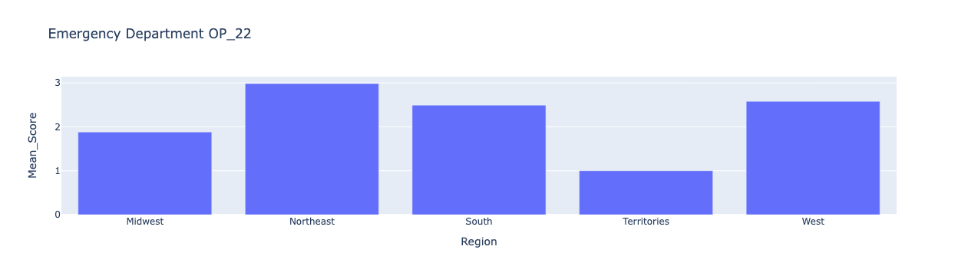
2.3 TIMELY AND EFFECTIVE CARE - EMERGENCY-1

Slide 27
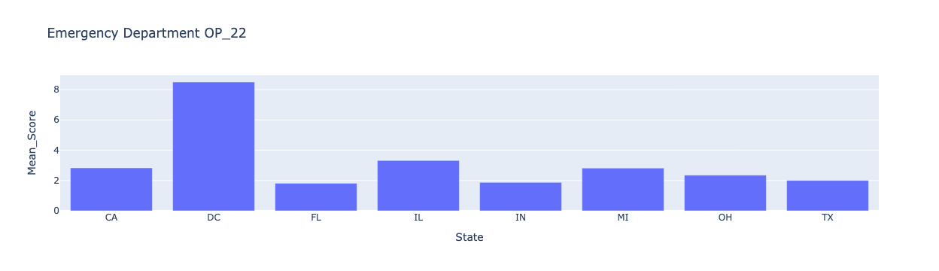
2.3 TIMELY AND EFFECTIVE CARE - EMERGENCY-1

Slide 28
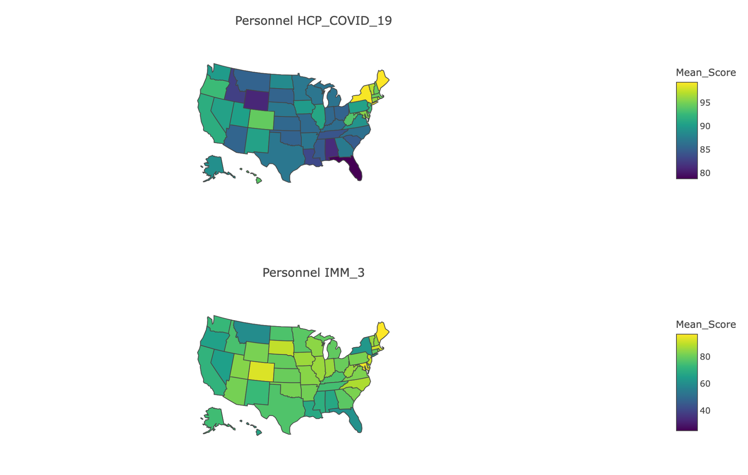
2.3 TIMELY AND EFFECTIVE CARE - VACCINATION

Slide 29
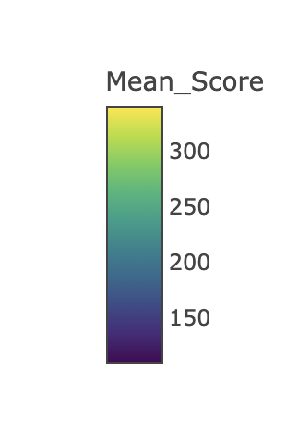
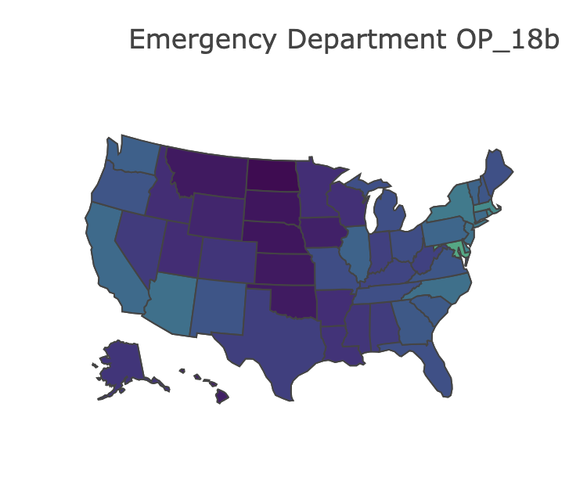
2.3 TIMELY AND EFFECTIVE CARE - EMERGENCY-2

Slide 30
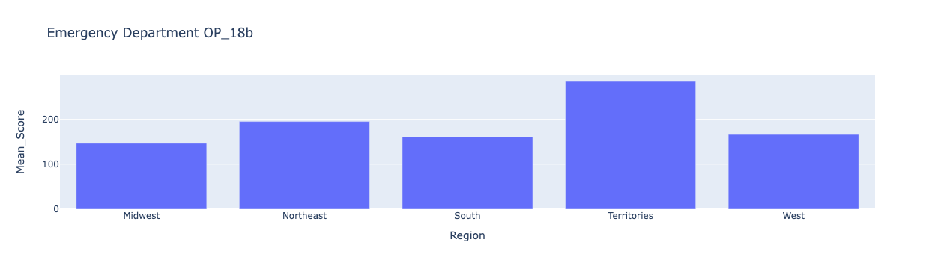
2.3 TIMELY AND EFFECTIVE CARE - EMERGENCY-2

Slide 31
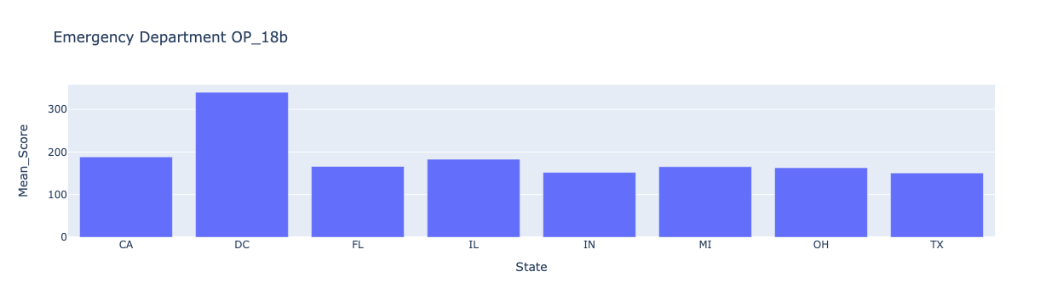
2.3 TIMELY AND EFFECTIVE CARE - EMERGENCY-2

Slide 32
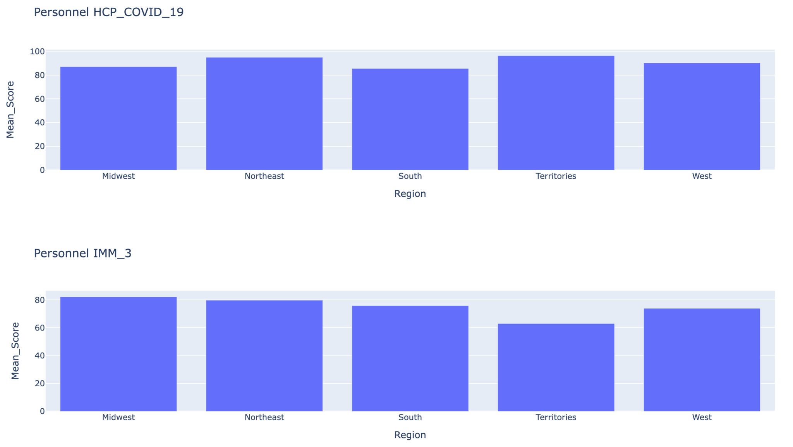
2.3 TIMELY AND EFFECTIVE CARE - VACCINATION

Slide 33
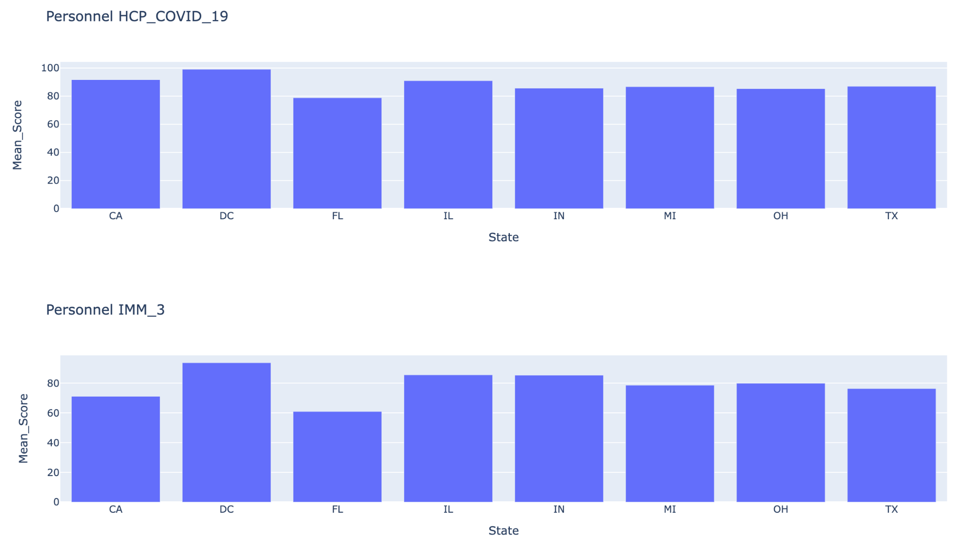
2.3 TIMELY AND EFFECTIVE CARE - VACCINATION

Slide 34
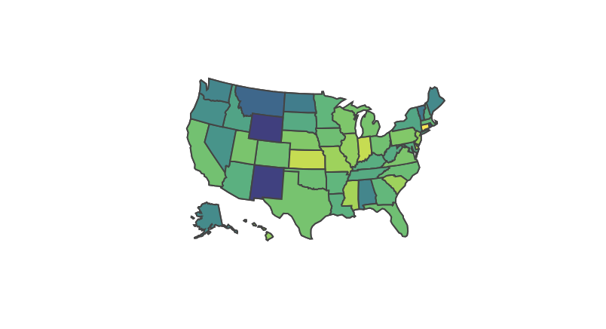
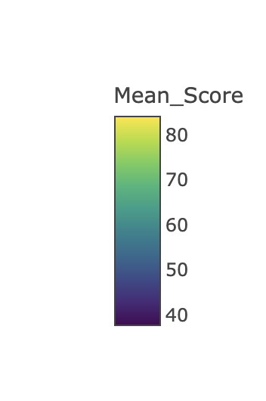
2.3 TIMELY AND EFFECTIVE CARE - STROKE

Slide 35
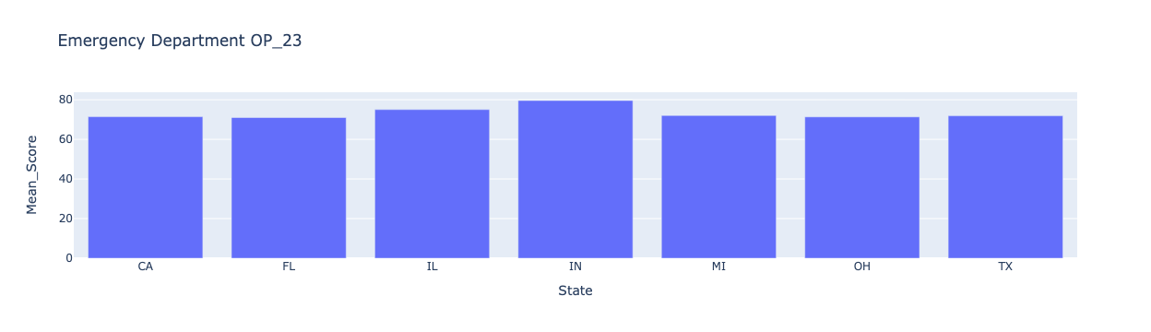
2.3 TIMELY AND EFFECTIVE CARE - STROKE

Slide 36
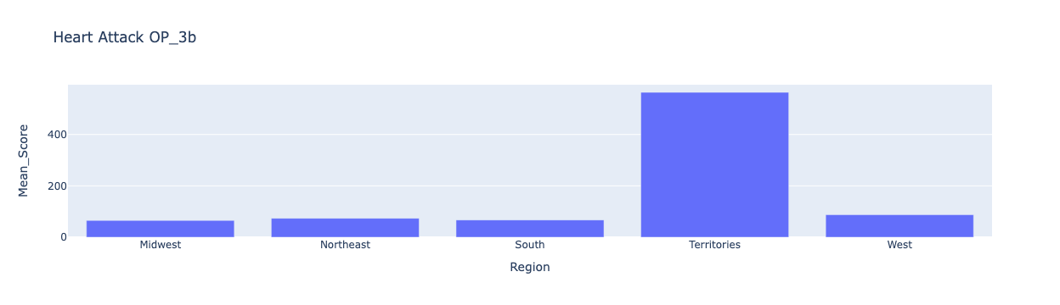
2.3 TIMELY AND EFFECTIVE CARE - HEART ATTACK

Slide 37
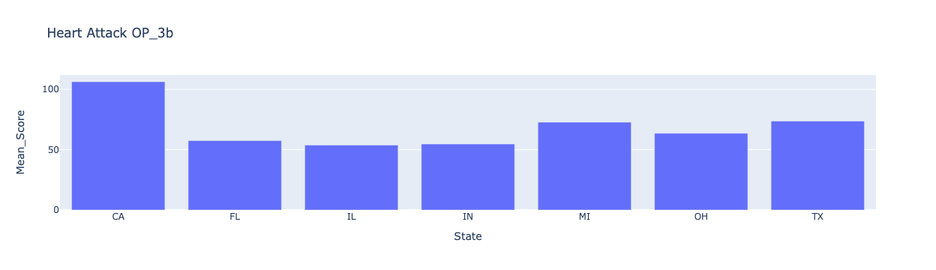
2.3 TIMELY AND EFFECTIVE CARE - HEART ATTACK

Slide 38
2.3 TIMELY AND EFFECTIVE CARE
EMERGENCY :
Midwest - patients left unseen and time spent
US Territories - long E.R. time
DC - many unseen patients up to 8%
PERSONNEL VACCINATION : Average covid shot coverage at 88% and around 80% lowest (Florida)
STROKE : Nation average at 70.25% - lowest New Mexico and Wyoming
HEART ATTACK : Nation average at 72.87 minutes to Transfer to Another Facility for Acute Coronary Intervention

Slide 39
03.
JOINT ANALYSIS

Slide 40
 | PAYMENT | NO. OF FACILITIES | HOSPITAL RATING | STAFF RESPONSIVENESS | CARE TRANSITION | EMERGENCY | VACCINATION
MIDWEST | 56,790,057 | 1,342 | 88.4 | 1st | 1st | 1.88% | 87%
SOUTH | 81,970,420 | 1,697 | 87.16 | 2nd | 2nd | 2.49% | 85%
WEST | 40,962,159 | 925 | 86.78 | 3rd | 3rd | 2.58% | 90%
NORTHEAST | 34,143,874 | 552 | 85.85 | 4th | 4th | 2.98% | 94%
TERRITORIES

Slide 41
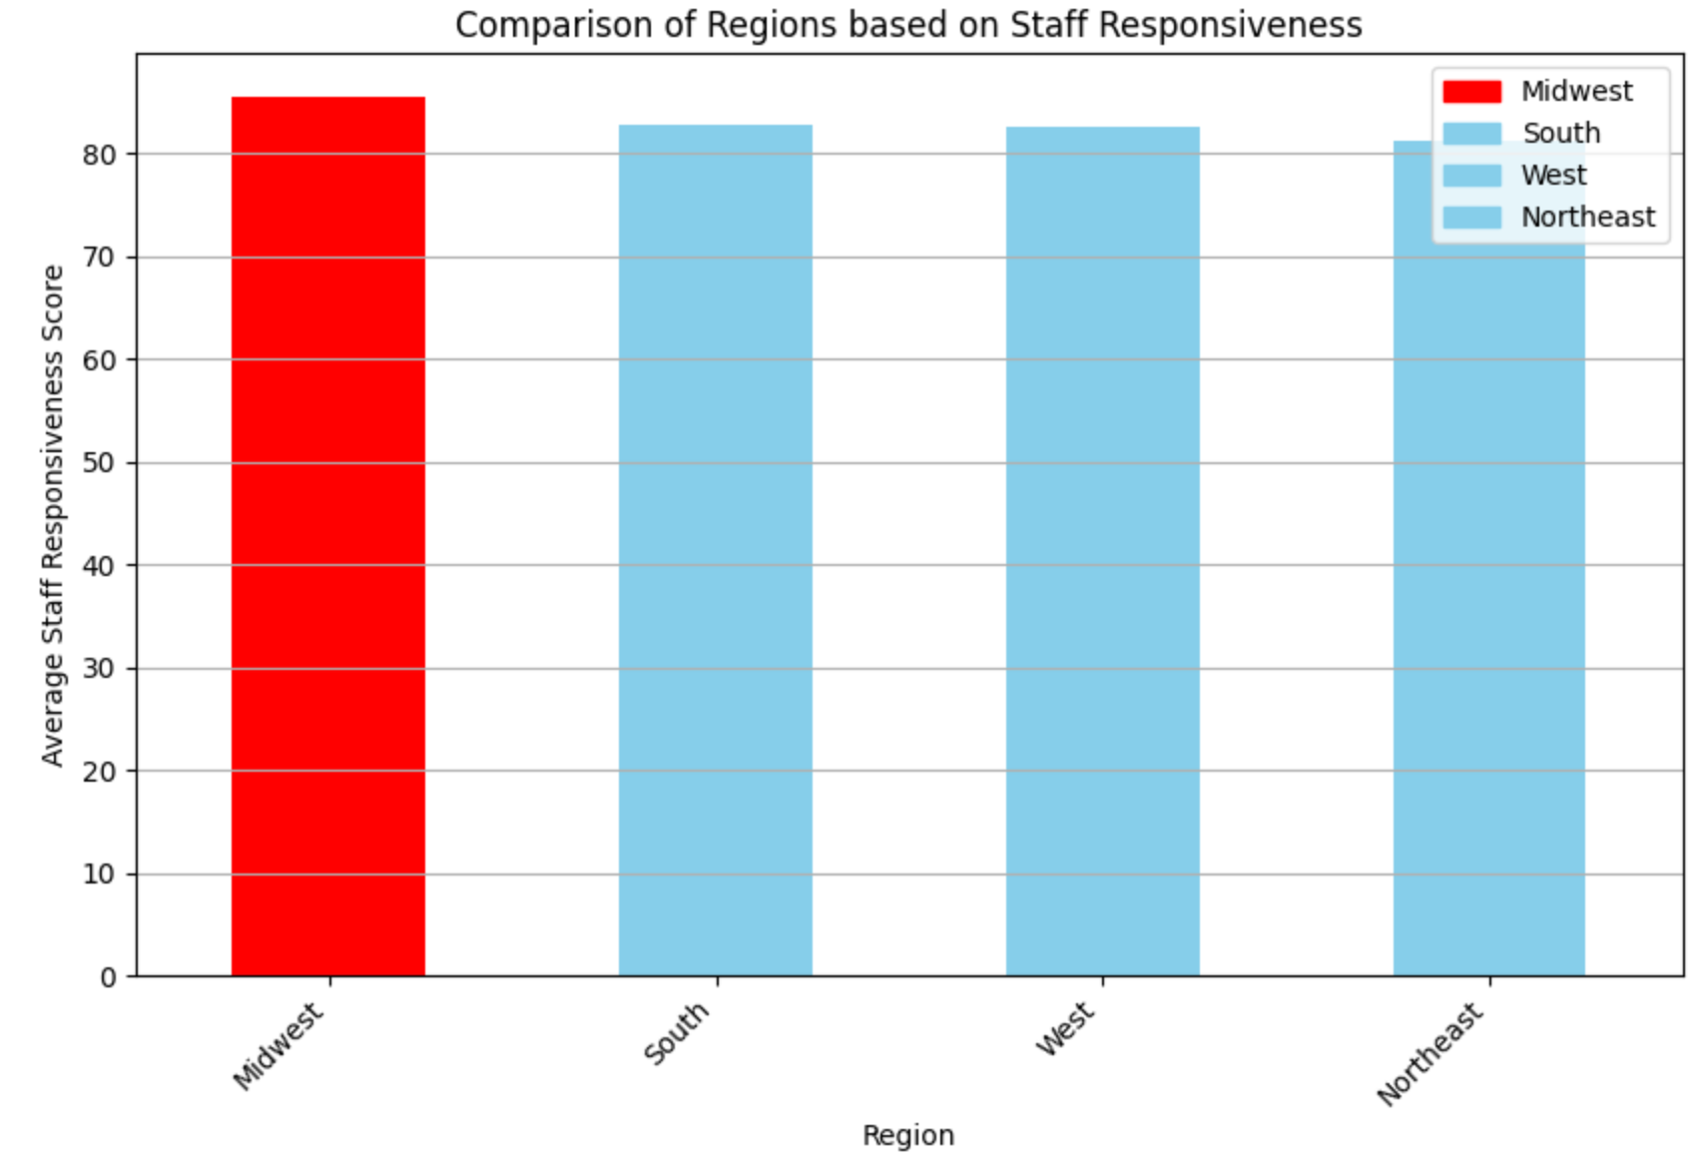
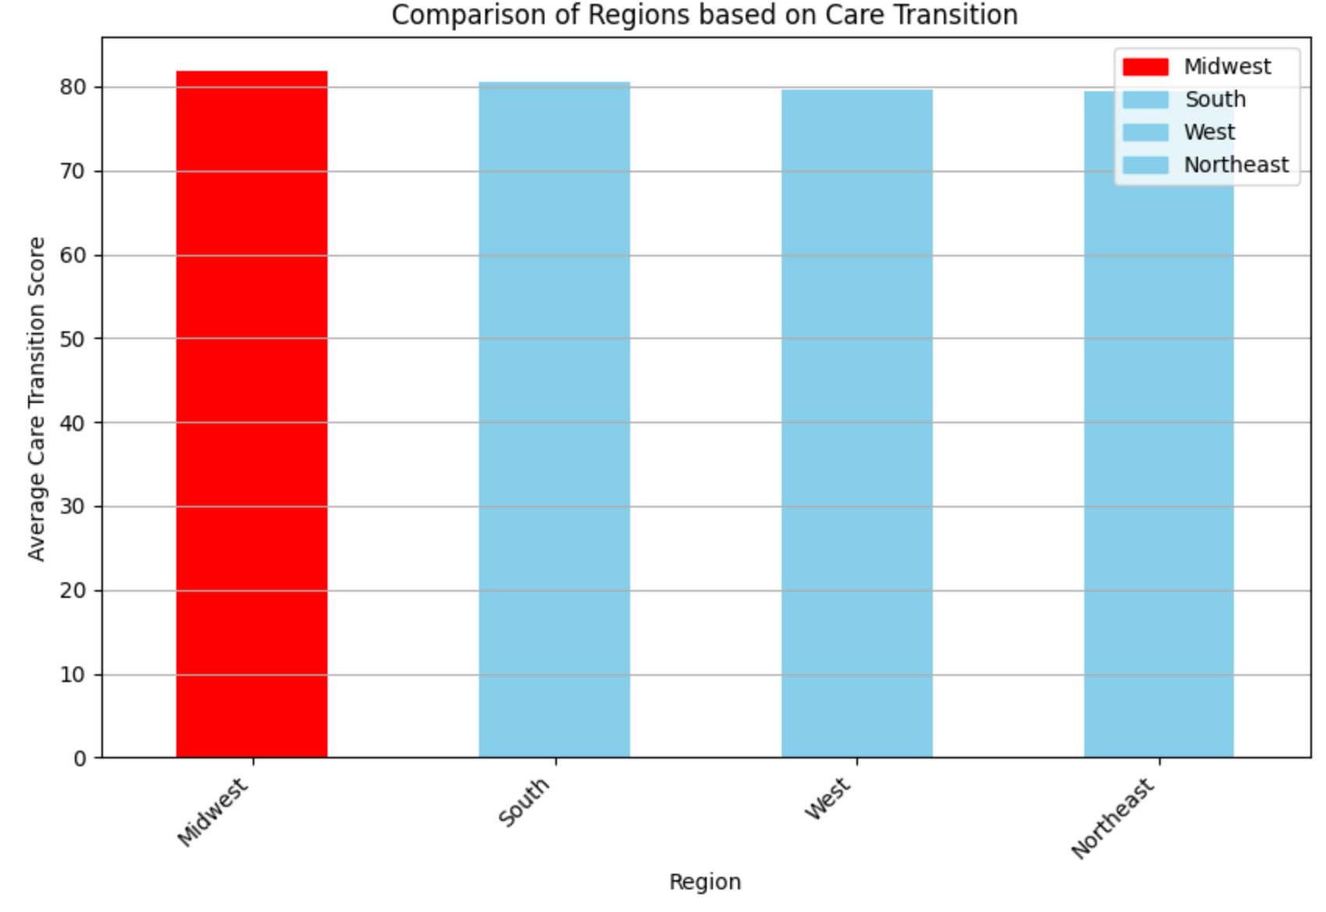
Comparison of Regions based on Staff Responsiveness and Care Transition
It was seen that out of all the attributes in Patient Satisfaction; Care Transition and Staff responsiveness was higher in the midwest regions and they ranked 1st compared to all other regions.

Slide 42
 | PAYMENT | NO. OF FACILITIES | STAFF RESPONSIVENESS | CARE TRANSITION | EMERGENCY | VACCINATION
IN | 6,041,647 | 116 | 1st | 1st | 1.88% | 85.65%
CA | 17,450,375 | 319 | 3rd | 3rd | 2.83% | 91.64%
TX | 16,080,207 | 358 | 2nd | 2nd | 2.58% | 90%
DC | 448,774 | 6 | 5th | 5th | 2.98% | 94%
FL | 12,702,206 | 177 | 4th | 4th | 2.98% | 94%

Slide 43
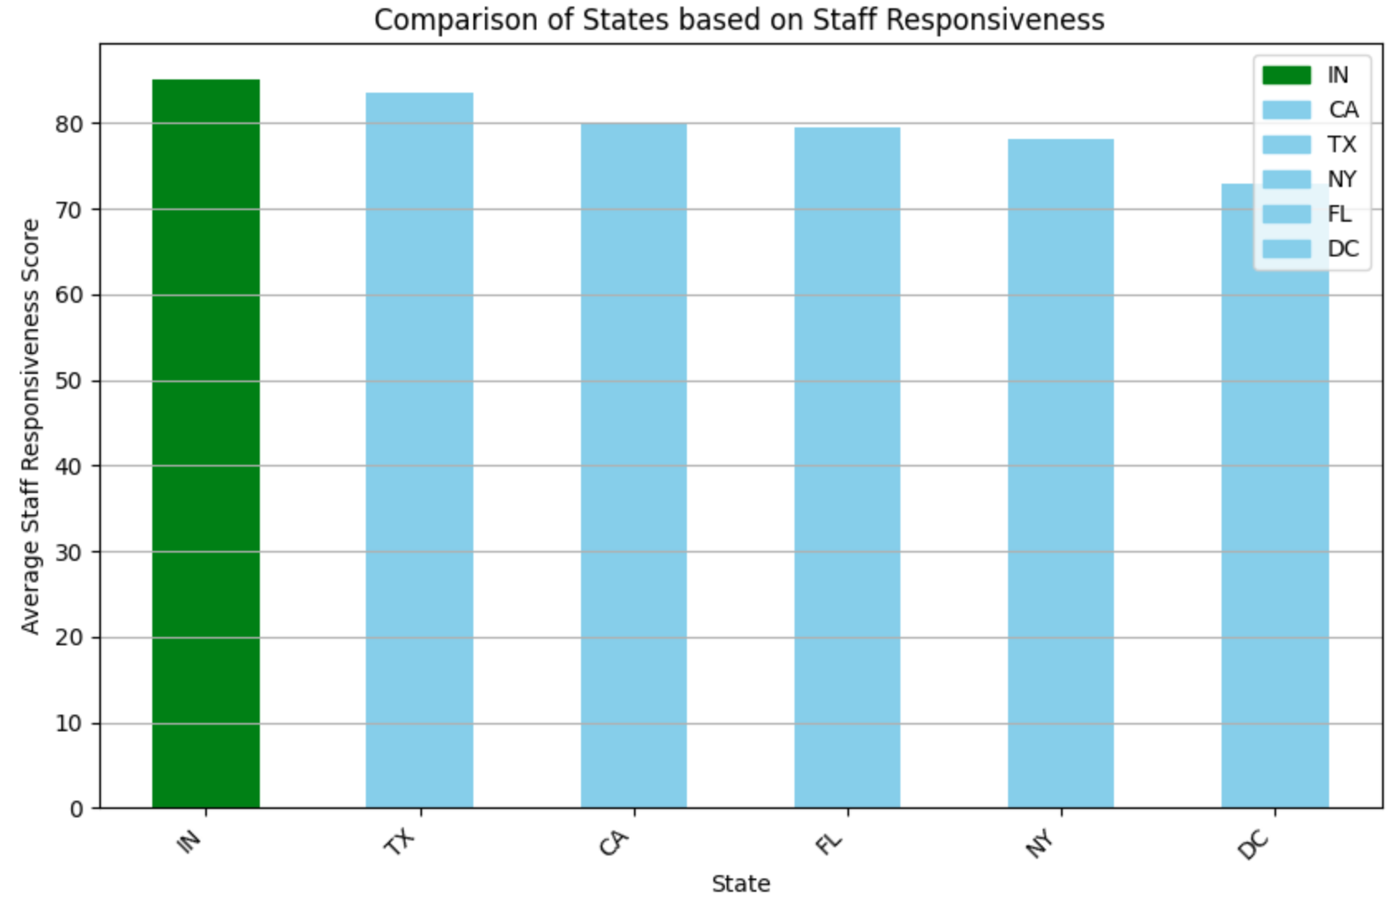
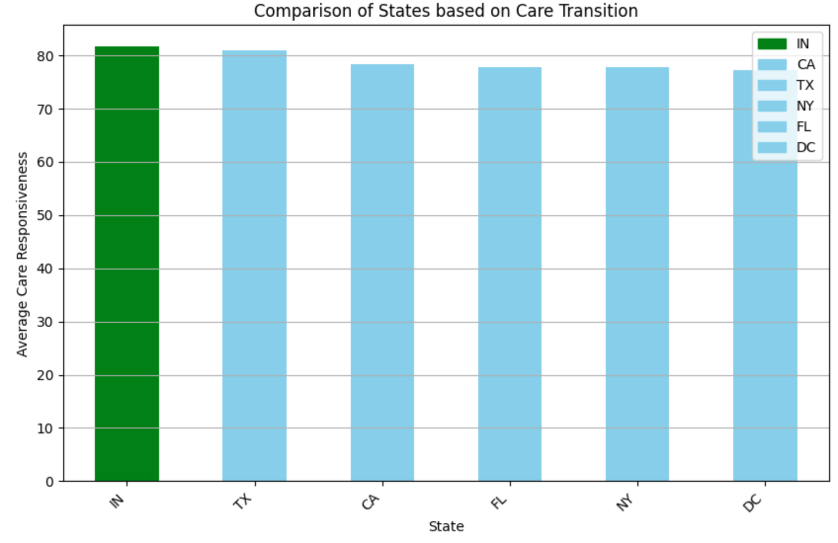
Comparison of States based on Care Transition & Staff Responsiveness
Through further analysis, comparing Indiana to all the other major states, Indiana ranks 1st in Care Transition and Staff Responsiveness making them the most rated on attribute out of all the others.

Slide 44
CONCLUSION

Slide 45
CONCLUSION
Based on the three factors: Payment, Hospital Experience and Timely & Effective Care:
There are differences between regions and states:
Midwest has the best public healthcare (2nd most payment - 1st in overall rating, staff responsiveness and care transition - lowest emergency wait time and most ER patients seen by doctor
Northeast region has lowest staff responsiveness and caretrasition
US territories has lowest rating
Despite difference, the experience for public healthcare nationwide is consistent
Payment and number of facilities
Overall experience
Emergency services findings are mostly the same with few exception

Slide 46
CHALLENGE
Public healthcare is rare with only a few exception
Even then, data is very broad and some features are medical related. (around 70 tables + 90-page codebook).
A lot of the features are different by only a little bit- there is no significant pattern
The reason we perform analysis separately : tables are not entirely unrelated or correlated, but it was hard to merge efficiently.
Want to make analysis over time, but data is duplicated due to collection period. This would require extra effort
Scope of work changed from make a ranking system to descriptive analysis.
Future work: If we have data on cost of living or maybe overall tax by states, we can combine with payments to see how effective the care system that state is
Future work: Compare to other researches and their findings.

Slide 47
THANKS!
Do you have any questions?

